Slide 1

uBox
Yuval Alfassi Ilan Godik

Slide 2


Nowadays Cloud Services
Size Limitations
Server failures and DDos vulnerability

Slide 3



The Solution - uBox
Server failures
Peer to peer
Size limitation
No central server
Torrent like protocol

Slide 4

Technique
Windows Explorer
User
Peer to peer

Slide 5

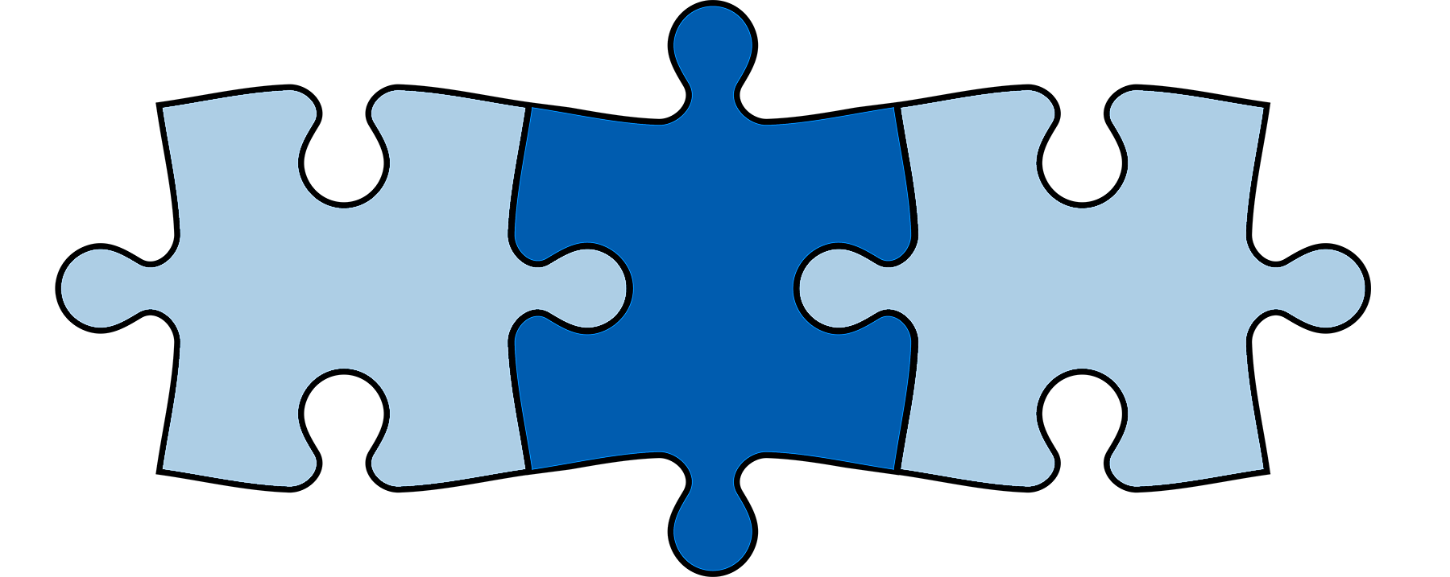
User Experience
Windows explorer drive
Can follow or clone other drives
Taskbar icon

Slide 6
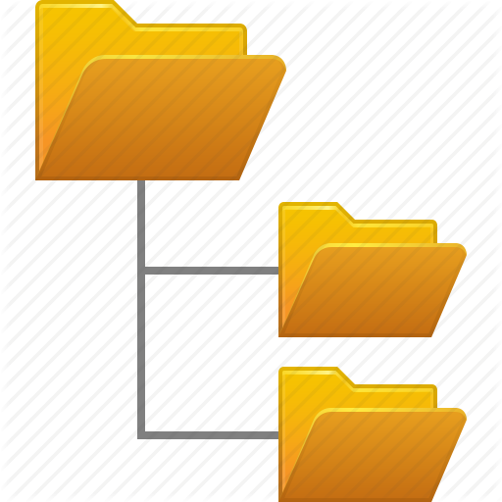


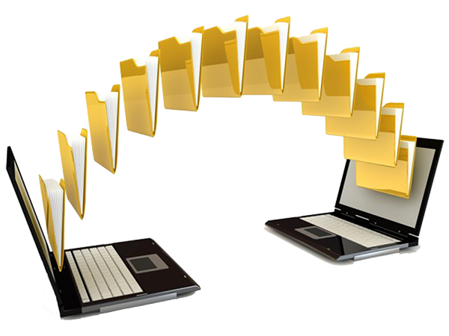
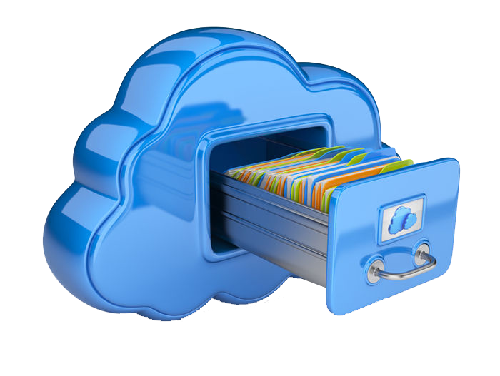
Possible Usages
Private use
Course management
Data center virtualization
File sharing

Slide 7

Challenges
Concurrency Race Conditions
Undebuggable code
Registry Manipulations
Notes:
Concurrency race conditions – it can come from nowhere - corrupted data.. multidimantionality
Interprocess communictation – lots of processes running – used TCP on LocalHost
Registry manipulation – right click, taskar icon, icon overlay
------------
Blue screen of death story. Buggy code causes blue screen. Formatted computer twice. Advice: Implement on Virtual Machine

Slide 8

IPFS
IPFS: Distributed protocols
Notes:
Aim: Distributed network, distributed file system, no central server (opposed to Google or Dropbox)

Slide 9
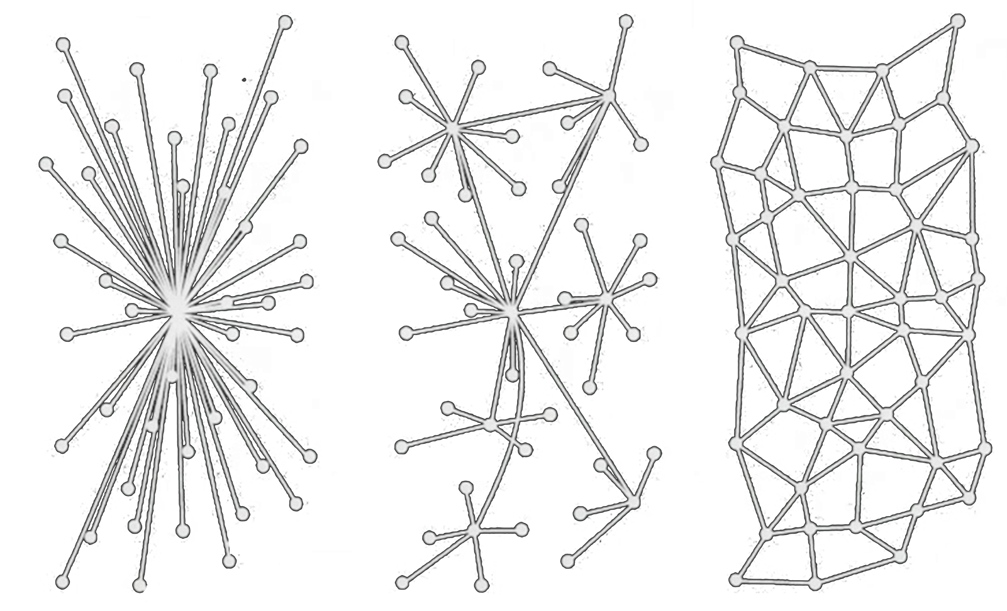
Peer To Peer
Centralized
Decentralized
Distributed
Notes:
Aim: Distributed network, distributed file system, no central server (opposed to Google or Dropbox)

Slide 10

Content Addressing
Notes:
File by its content. Content -> request CryptoHash of file. תמצית שמתארת אותו

Slide 11
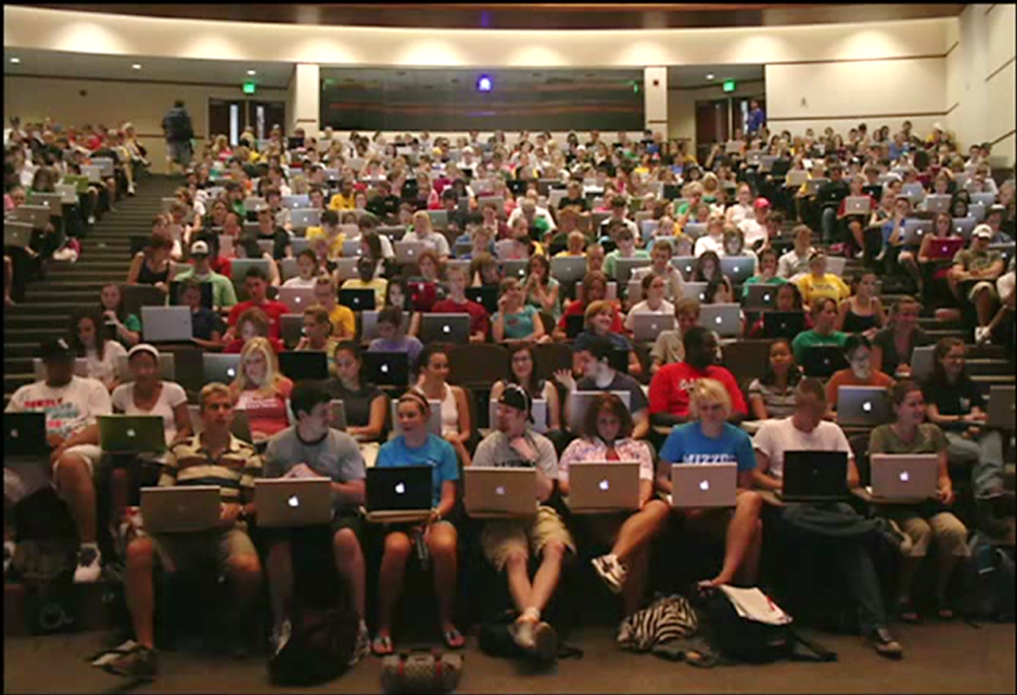
Local Fetching
Notes:
Fetch files locally – don’t go to server. Example: Hackathon, Course, Laptop.

Slide 12

Deduplication

Slide 13
Mutable links
Identity
Hash1
Hash2

Slide 14
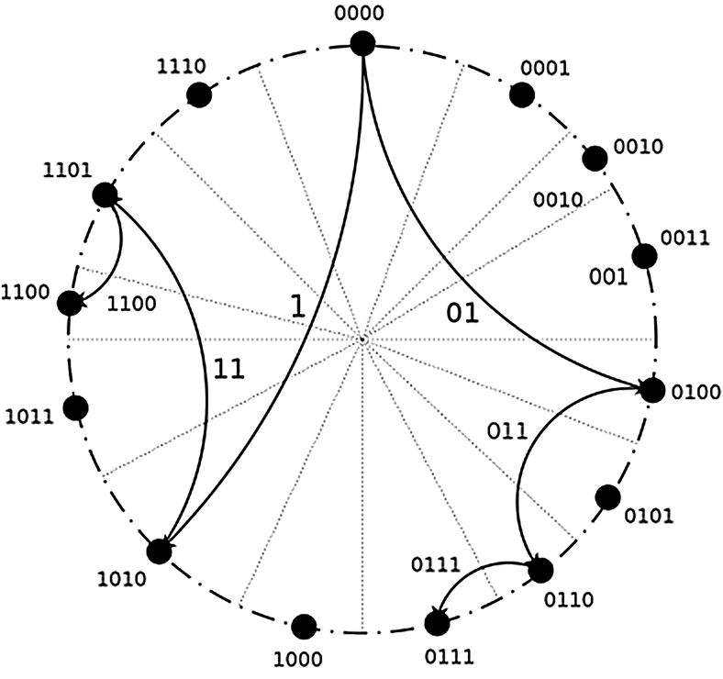
Distributed Hash Table

Slide 15
Prefix Substitution Languages
A
x
b
y
z
c

Slide 16
Prefix Substitution Languages
A
D
x
b
f
i
y
z
c
g
h

Slide 17
Prefix Substitution Languages
A
D
x
b
f
i
y
z
c
g
h

Slide 18
Sharing
A
B
x
b
a
y

Slide 19

Bad Loops
A
B
b
a
B/a/a
A/b/b
$$A/b→B/a/a →A/b/b/a →B/a/a/b/a →A/b/b/a/b/a$$

Slide 20
Prefix Substitution Languages
A
D
x
b
f
i
y
z
c
g
h

Slide 21
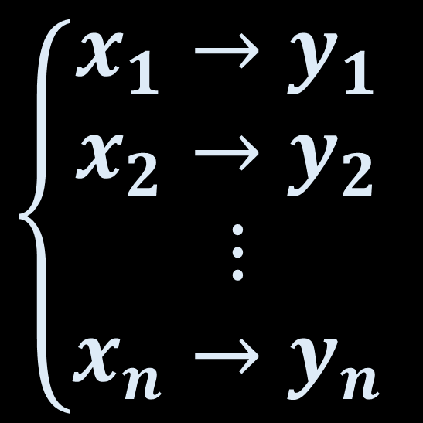
Prefix Substitution Languages
Prefix Substitution Languages
$$\left\{\begin{aligned}x_{1}→y_{1} \\ x_{2}→y_{2} \\ ⋮ \\ x_{n}→y_{n} \end{aligned}\right.$$

Slide 22


Prefix Substitution Languages
A
D
x
b
f
i
y
z
c
g
h
Rules:
input $→$ output
$$\left\{\text{Abc} → \text{Df} \text{Abcg} → \text{Dfg}\right.$$

Slide 23
Prefix Substitution Languages
Question:
How do we know a system
stops for all inputs?
Halting Problem!

Slide 24
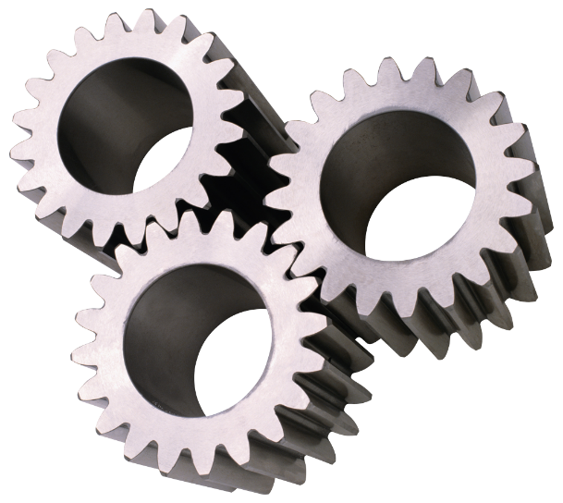
Prefix Substitution Languages
Theorem:
Internal Consistency implies
Consistency

Slide 25
Prefix Substitution Languages
Normalization:
All rules are not reducible

Slide 26
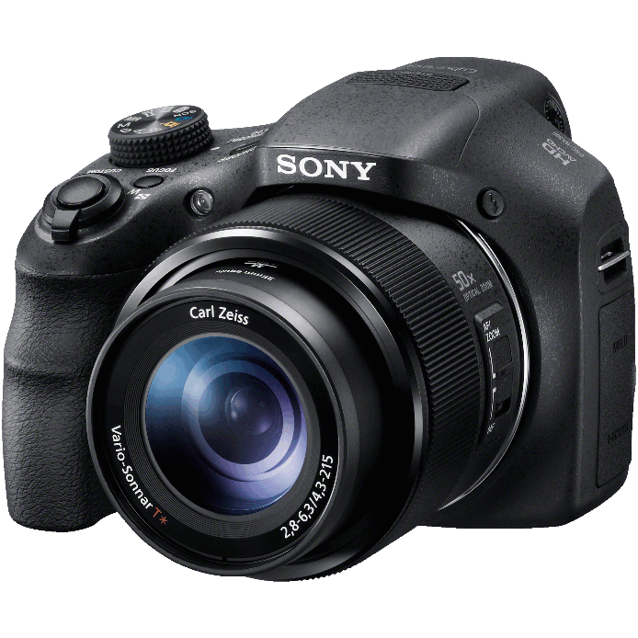

uBox sample Screenshots

Slide 27
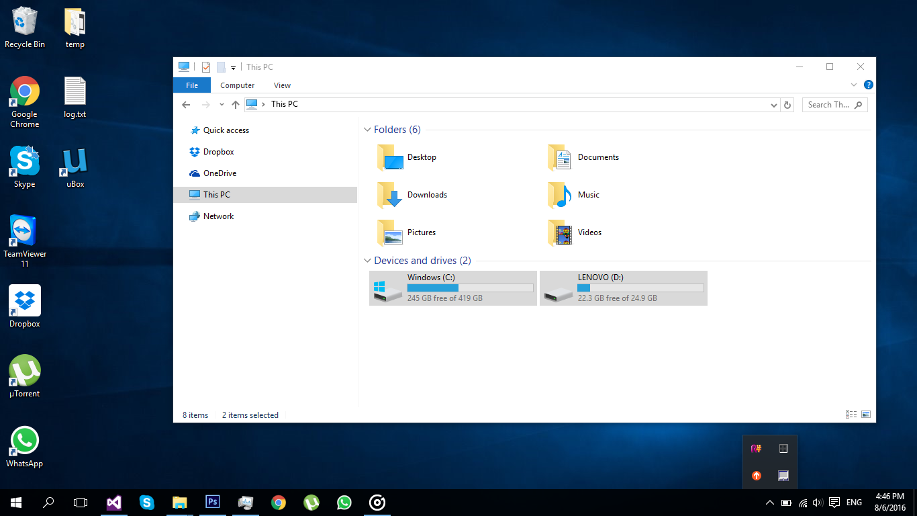
Double click uBox’ icon
Only C and D drives exist

Slide 29

uBox’ drive has mounted

Slide 30
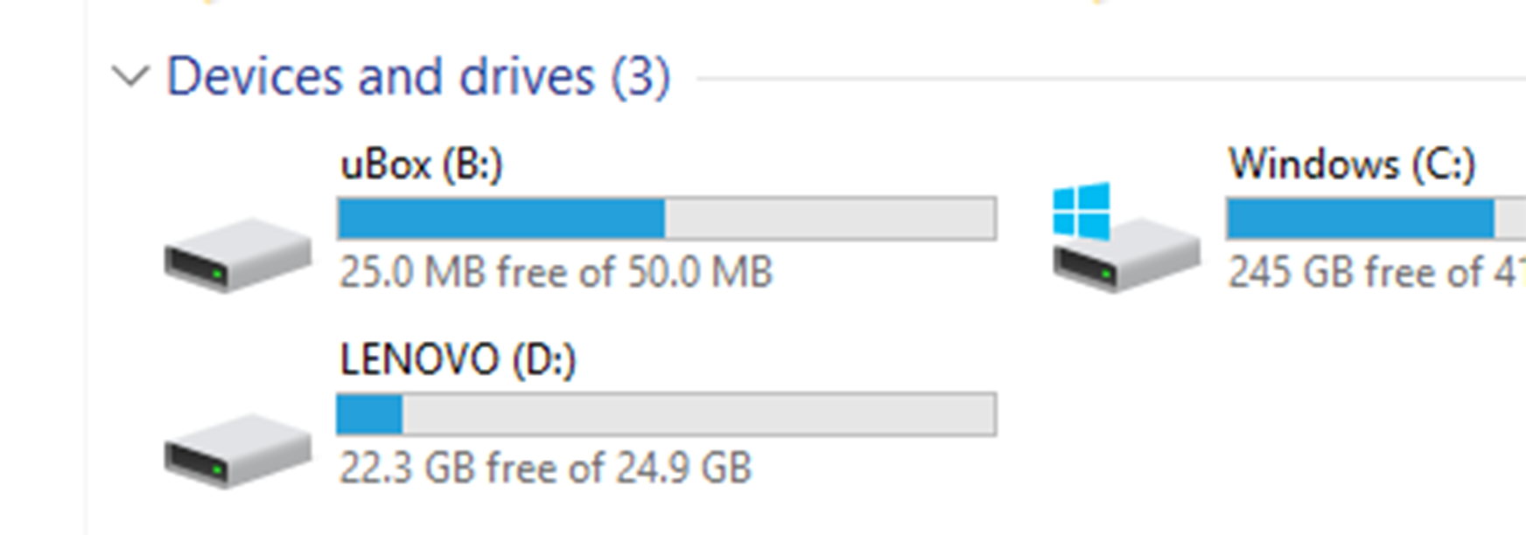

Slide 31
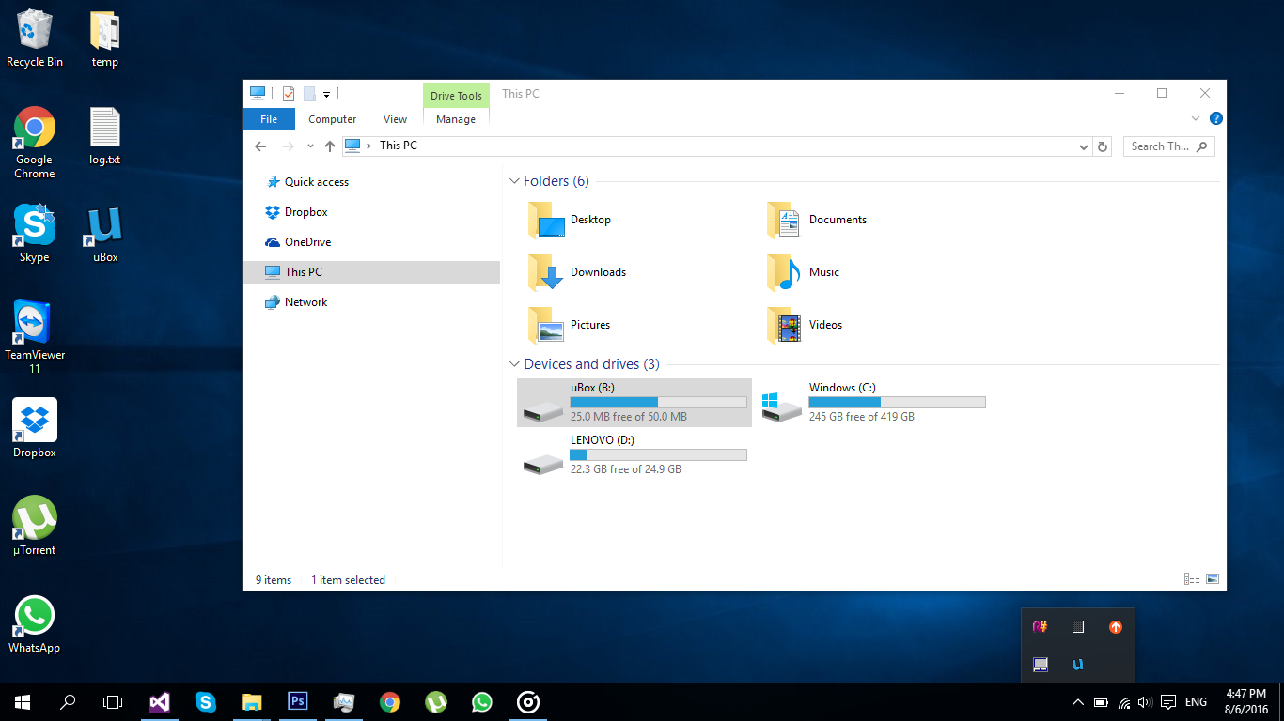
uBox’ taskbar icon

Slide 32
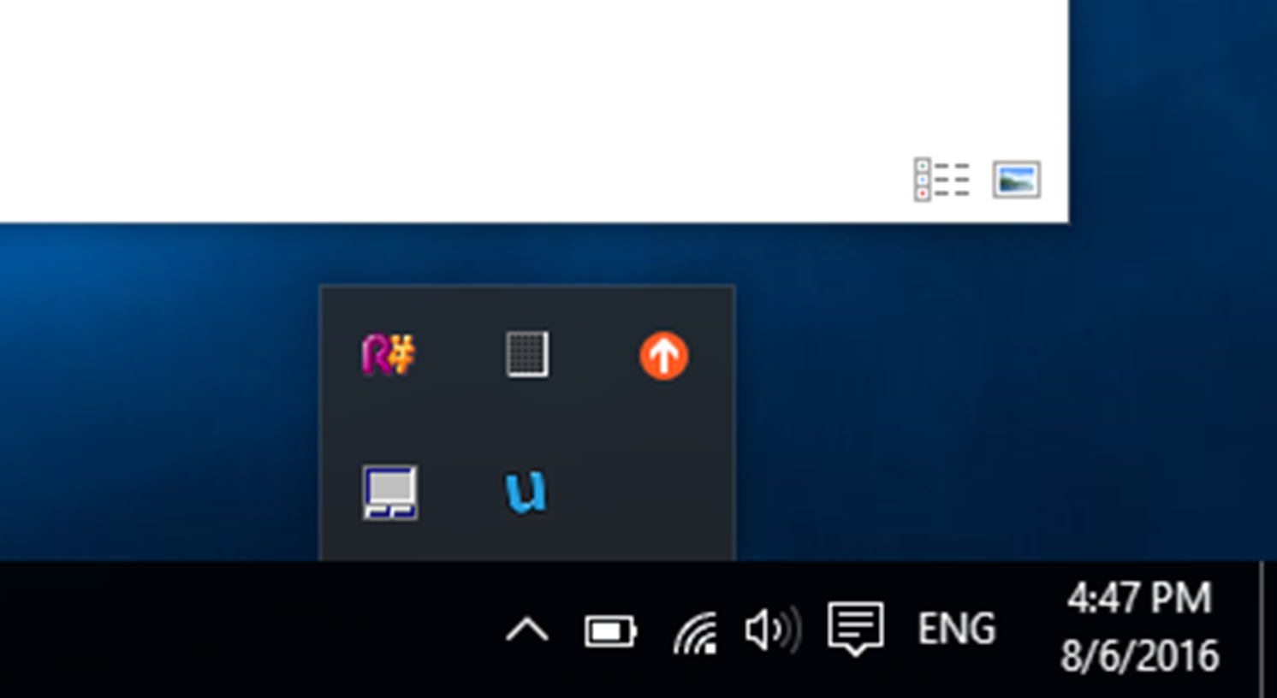

Slide 33
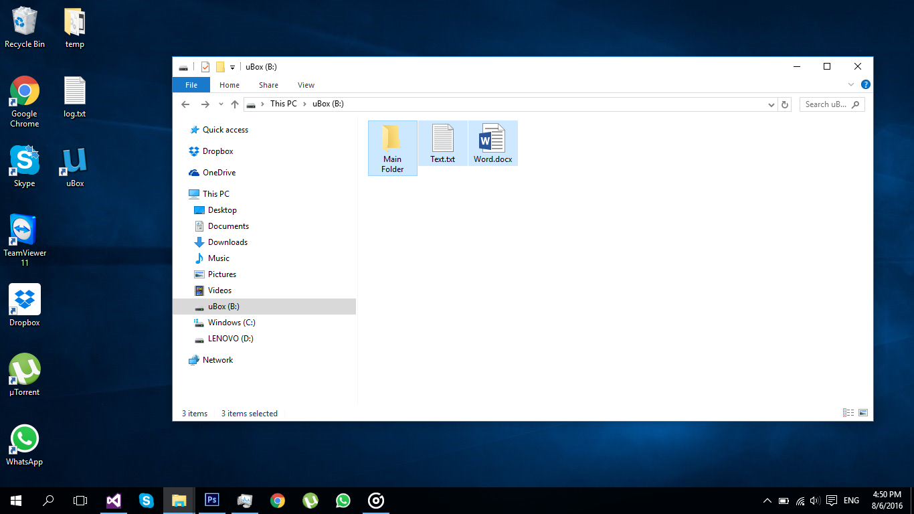
The files are not stored on the disk!

Slide 34
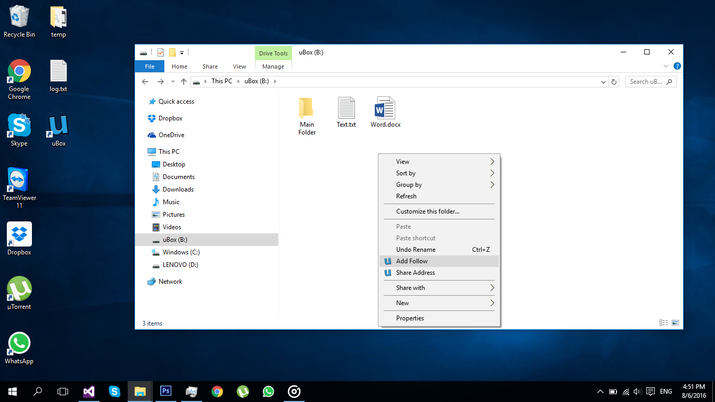

right click $→$ add follow

Slide 35
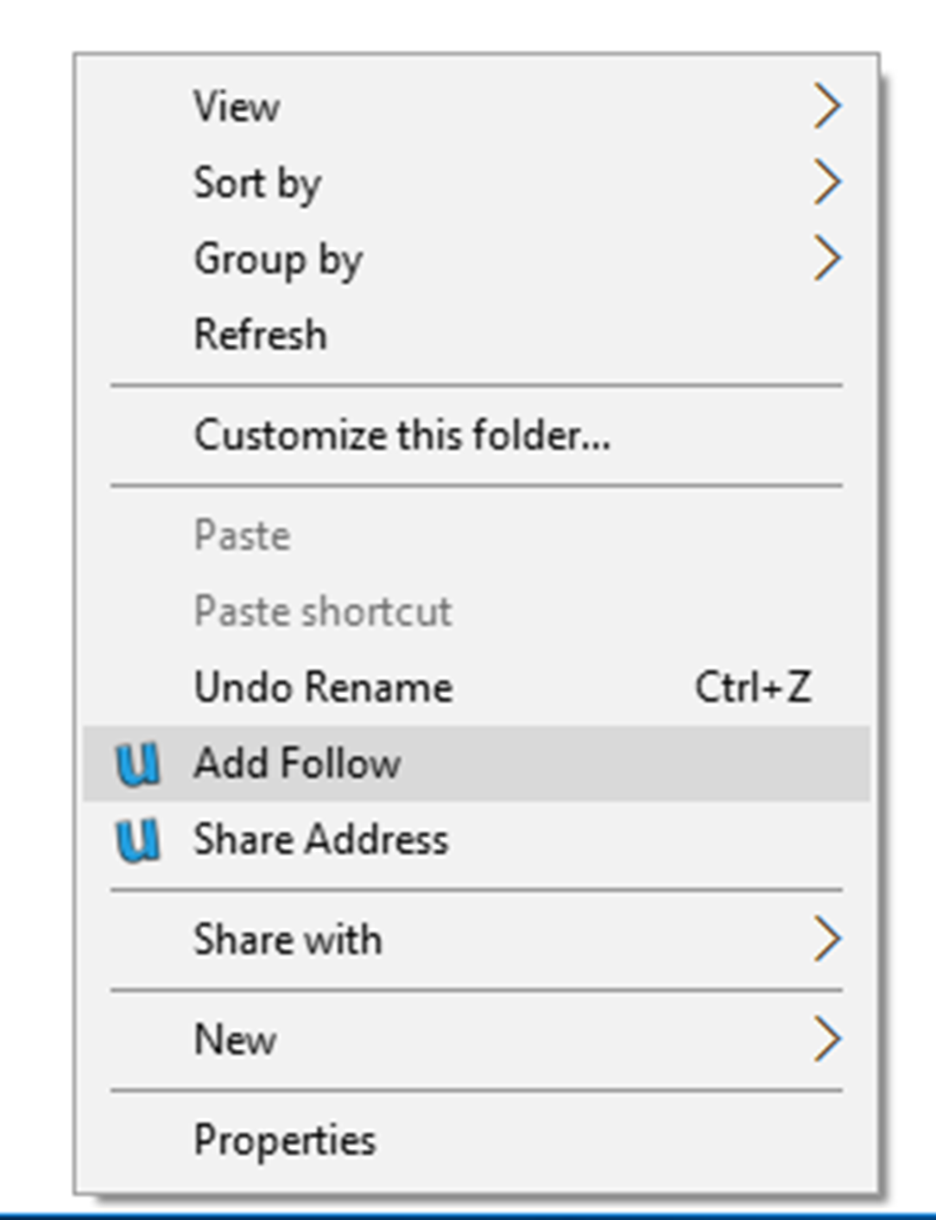

Slide 36
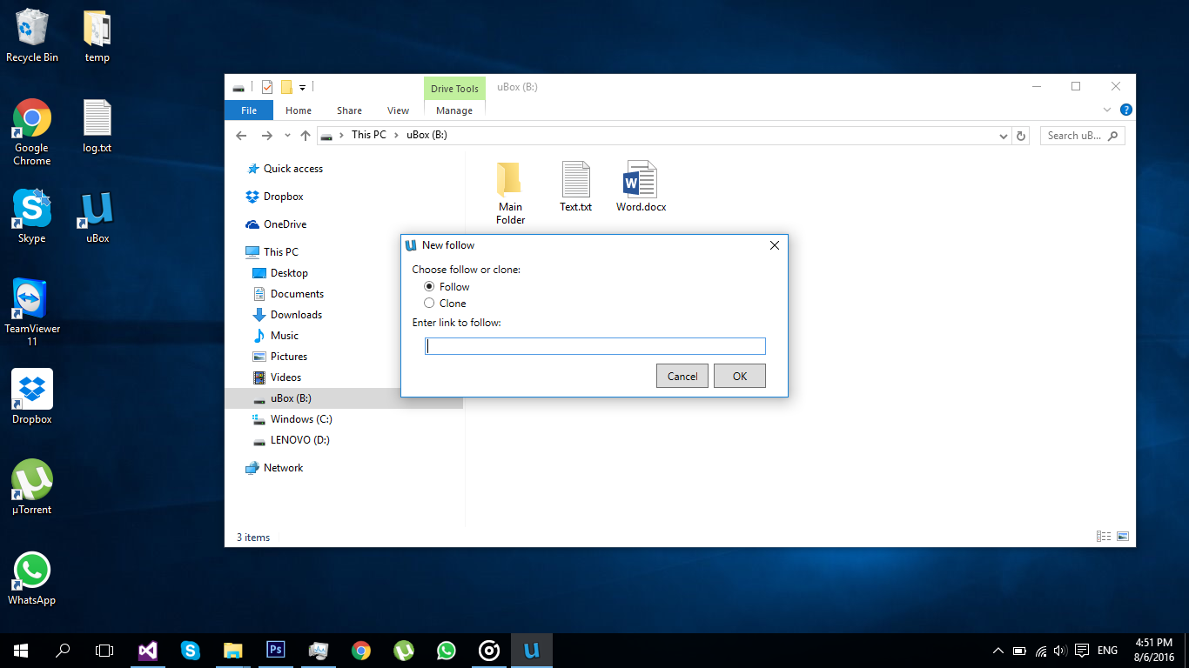
Clone or follow other drives

Slide 37

Clone or follow other drives

Slide 38
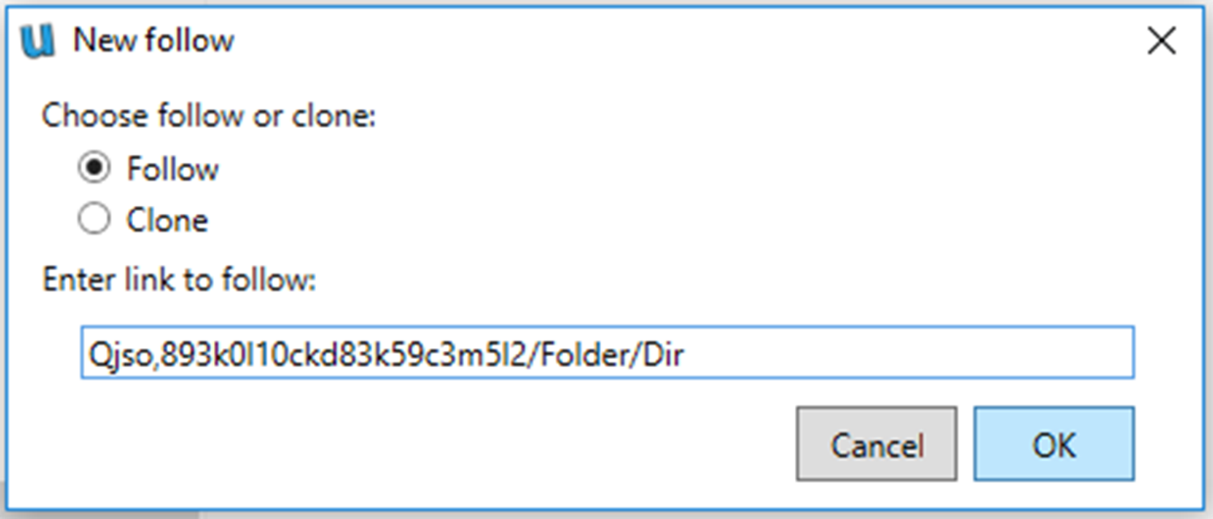

Slide 39

Followed folders marked to the user

Slide 40
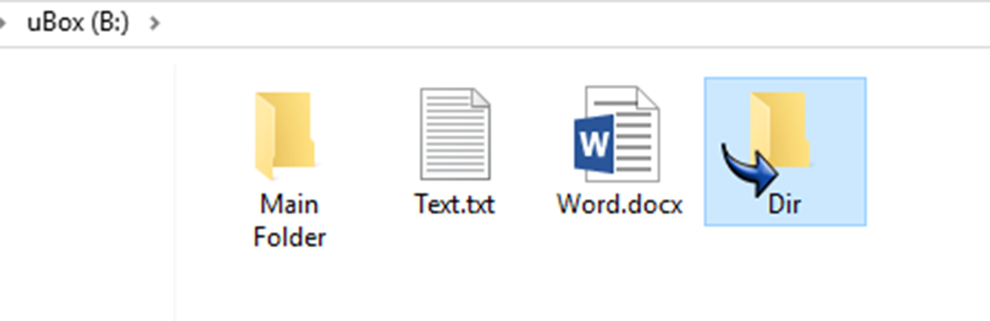

Slide 41
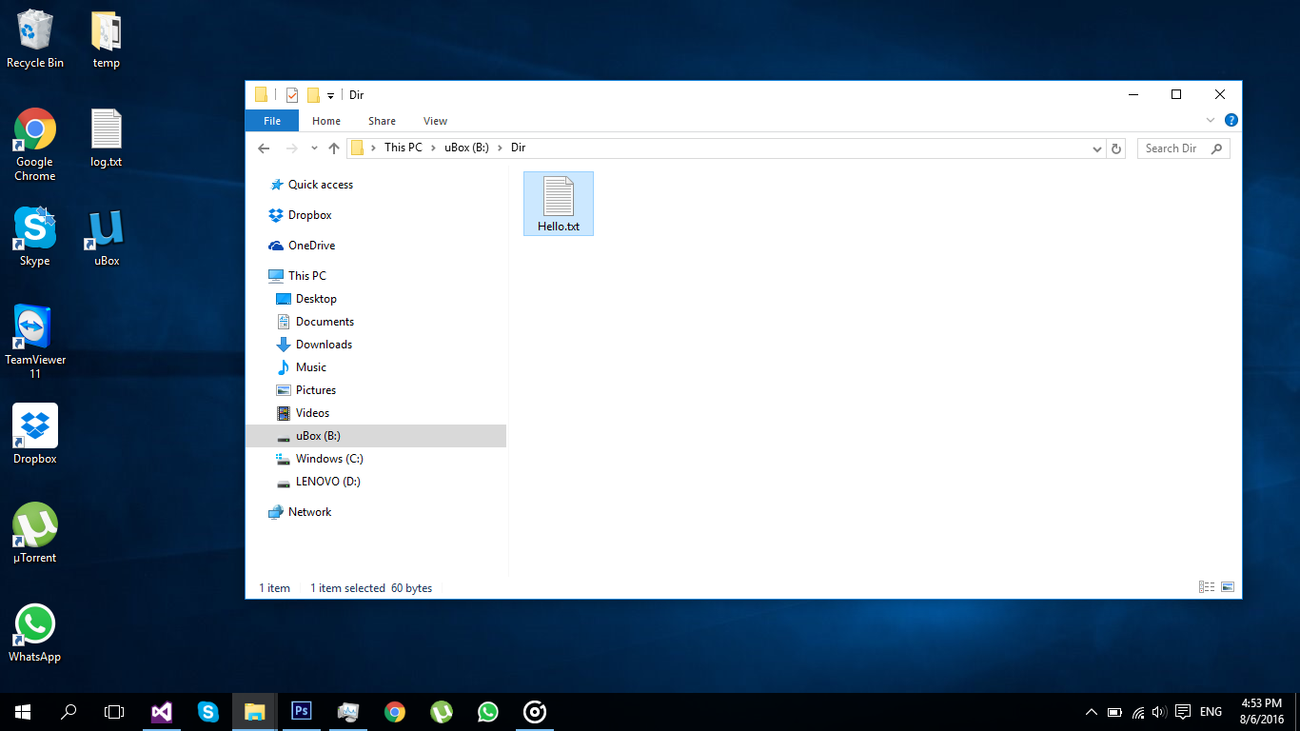
This file is stored elsewhere!

Slide 42
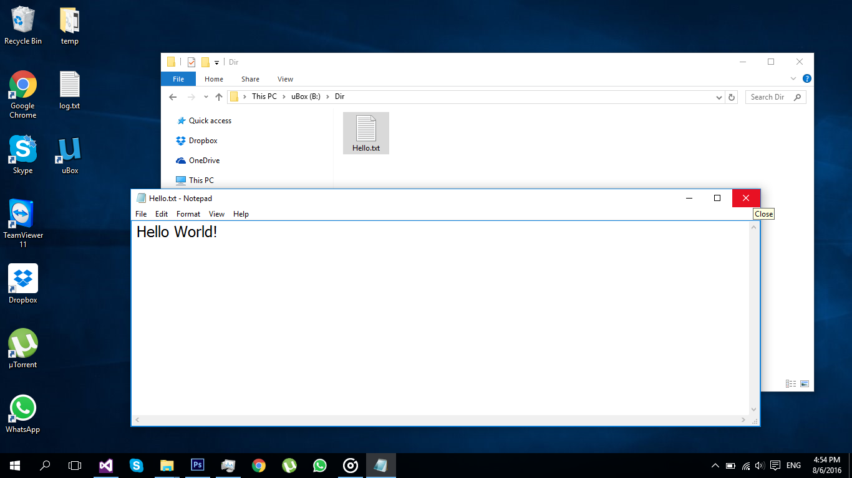
Data is synced automatically

Slide 43
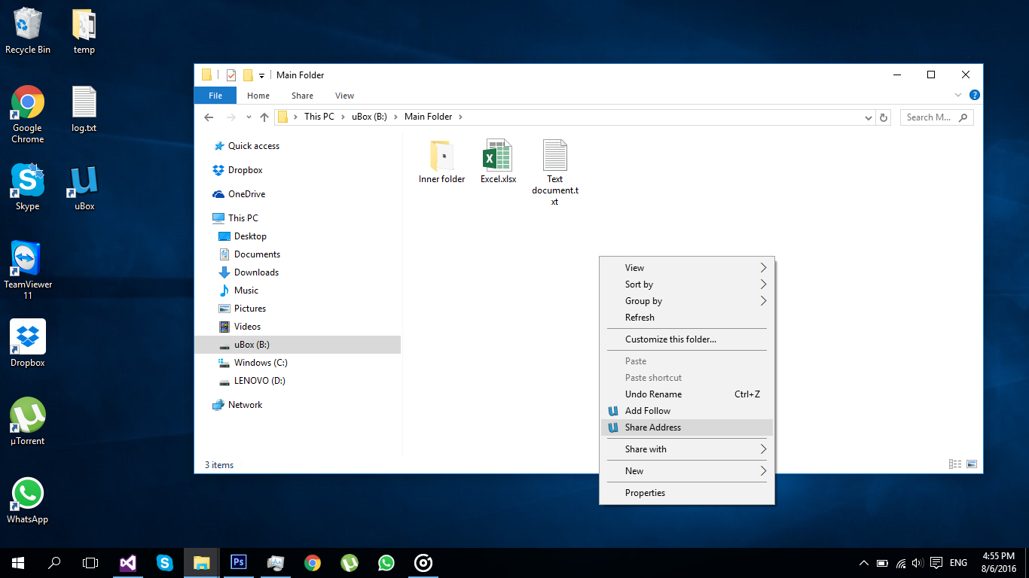
Share your address drive with others

Slide 44
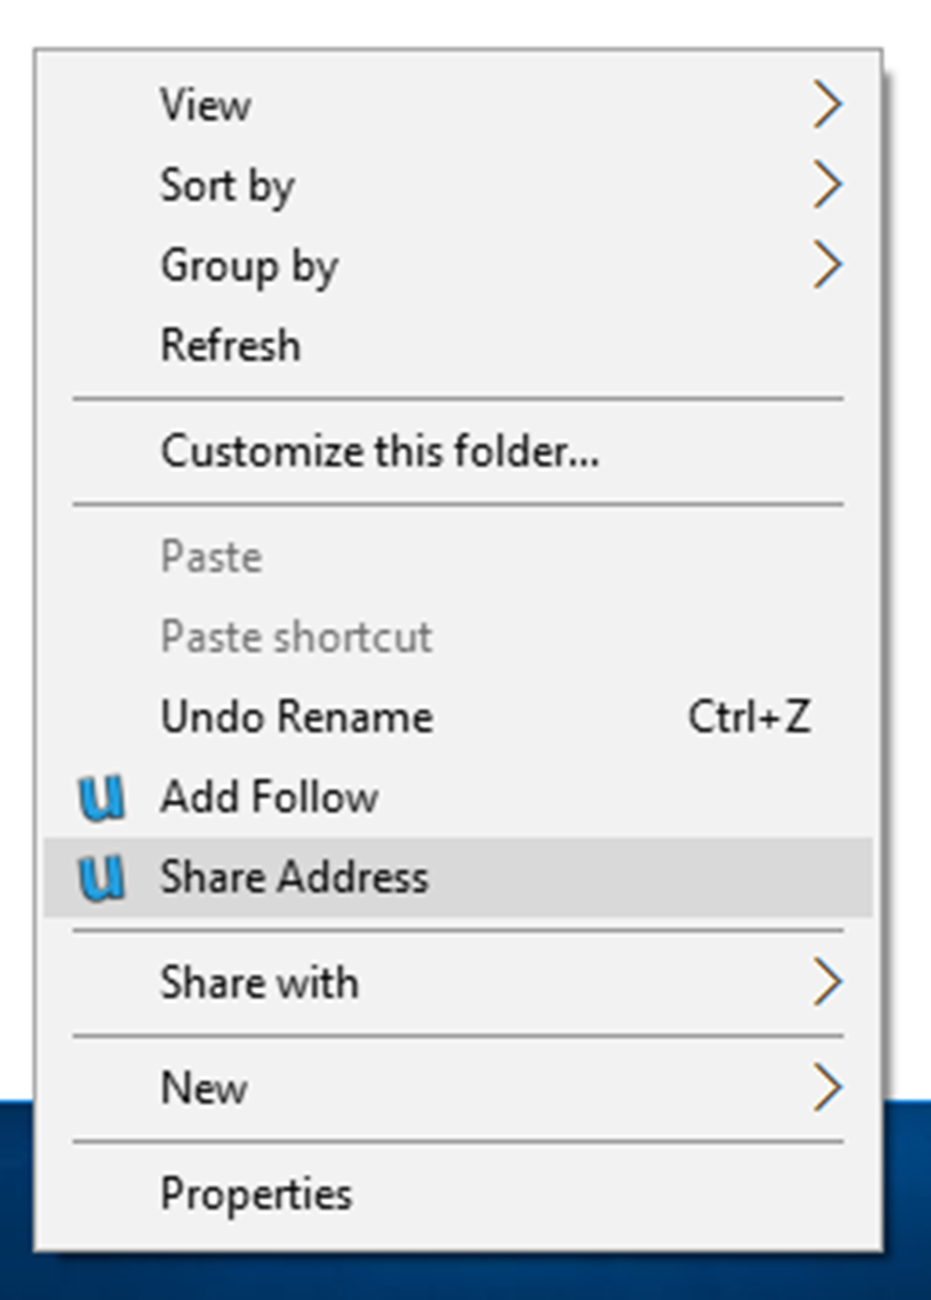

Slide 45

Copy address to clipboard

Slide 46
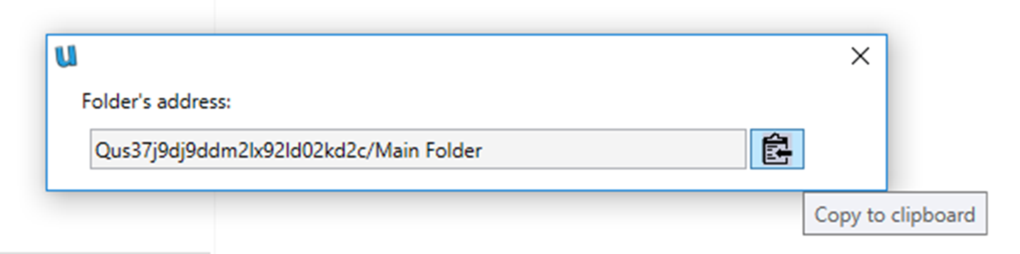

Slide 47
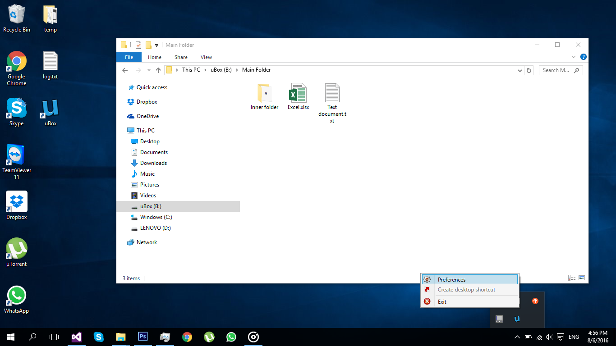
Edit settings

Slide 48
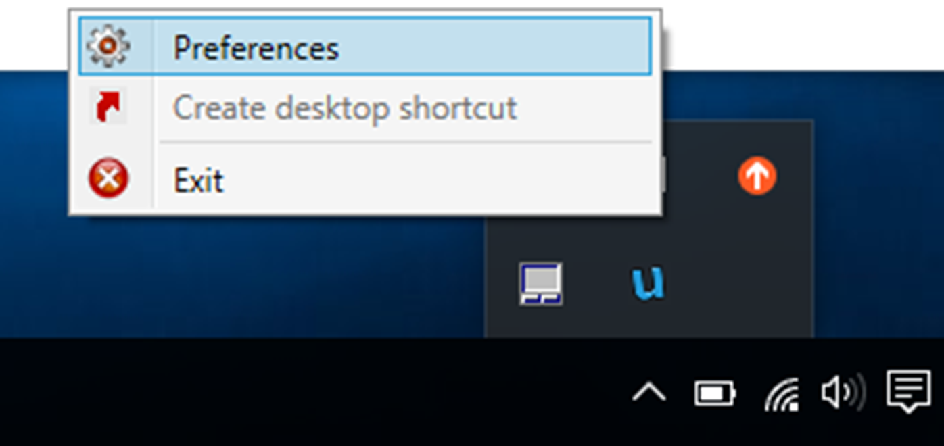

Slide 49

Change drive character to ‘P’

Slide 50

Can also sync index from somebody else

Slide 51
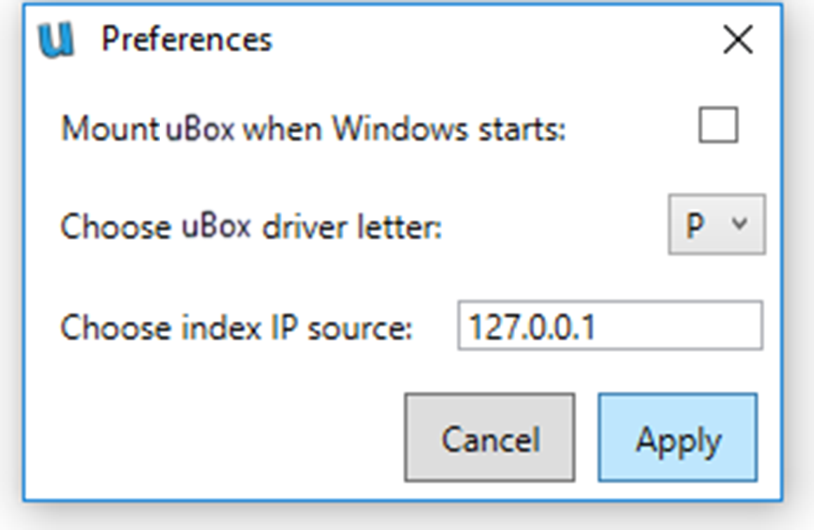

Slide 52

Drive character: ‘P’

Slide 53
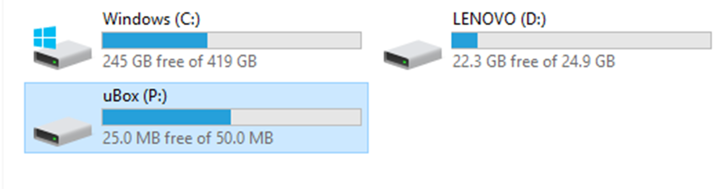

Slide 54

Technologies
IPFS
WPF
Windows
Dokan

Slide 55






Future Work
Suggest Changes
Keybase

Slide 56
Questions?
?

